Slide 1
Separation of P and Mn from Steelmaking Slag by Selective Reduction
Dong Jun SHIN¹, Xu GAO², Shigeru UEDA²
Shin-ya KITAMURA²
¹ Former student, Tohoku University
² IMRAM, Tohoku University

Slide 2
Contents
Separation of P and Mn from Steelmaking Slag by Selective Reduction
1. Introduction
2. Optimum Conditions of Basicity
Influence of Initial Al₂O₃ Content
Conclusion

Slide 3
Contents
Separation of P and Mn from Steelmaking Slag by Selective Reduction
1. Introduction
2. Optimum Conditions of Basicity
Influence of Initial Al₂O₃ Content
Conclusion

Slide 4
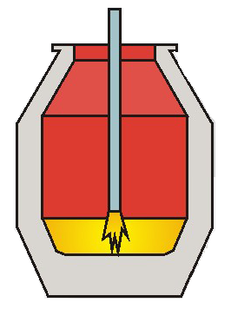
1. Introduction (Importance of P and Mn separation from steelmaking slag)
Re-use steelmaking slag into sintering process is useful to decrease slag generation
Al₂O₃
(2~6 %)
Major components in Steelmaking Slag
T.Fe
(10~24 %)
MgO
(3~9 %)
SiO₂
(11~23 %)
CaO
(31~48 %)
MnO
(2~6 %)
P₂O₅
(1~3 %)
Useful sources for sintering
Accumulates in hot metal
Accumulates in hot metal
Transfer into steelmaking slag again.
Separation of P and Mn from steelmaking slag in necessary
The value of P and Mn as resources in Japan^{[1,2]}
(Kton/year)
Iron Ore
Fertilizer
(110)
High Carbon
Fe-Mn (303)
Imported (584)
Food, Plant
410
Phosphate Rock
Low Carbon
Fe-Mn (48)
LD Slag
Imported
(110)
Mn Ore
110
Imported
(537)
EF Slag
Steel
Industry
(112)
Si-Mn (186)
Steelmaking
process
Unrecovered
(520)
Iron Ore
Steelmaking
Slag
(156)
Steelmaking
process
Unrecovered
(93)
Extraction of P and Mn in Steelmaking Slag Alternative Resource
References : [1] K. Yokoyama, et al., J. Ind. Ecol., 13(2009), 687. [2] K. Nakajima, et al: ISIJ Int., 2008, vol. 48, pp. 549−553.

Slide 5
1. Review for carbon reduction from steelmaking slag
Removal P and Mn from steelmaking slag by carbon reduction
S. Shiomi et al. ^{[1]}
- Recovery of Fe and P by carbon reduction from BOF
slag for reclamation
Li et al. ^{[2]}
- Revive steelmaking slag (Remove P from steelmaking
slag by carbon reduction) and re-use regenerated slag
into de-P process
K. Mortia et al. ^{[3]}
- Reduction behavior for P and Fe recovery by
microwave heating processing
Kenji Nakase et al. ^{[4]}
- Reduction tendency of P and Fe (T.Fe, Basicity) by
carbothermic reduction
Matsui et al. ^{[5]}
- Influence of temperature on reduction behavior of
Fe_{t}O and P₂O₅ by carbon reduction
By simple carbon reduction
Fe-P-Mn-C alloy is produced.
Additional process is necessary for utilization of P and Mn.
Different application for Mn and P
Mn
P
Valuable element for steel-product
Harmful element
for steel-product
Separation of P and Mn is essential,
but separation of P and Mn has not been considered by carbon reduction.
References
[1] S. Shiomi, et al, : Tetsu-to-Hagané 63 (1977) 1520–1528 [2] Li, H-J. et al, ISIJ international 35.9 (1995): 1079-1088.
[3] Morita Kazuki et al, JSMCWM 4.2 (2002): 93-101
[4] Kenji Nakase et al, ; ISIJ international 57:1197-1204.
[5] Matsui A, et al, : Tetsu-to-Hagané 97:416-422.

Slide 6
1. A proposal selective reduction of P from steelmaking slag
P₂O₅ is acidic oxide, MnO is basic oxide. Standard free energies for oxidation is widely different.
Coal
SiO₂
Carbon Reduction
Purpose: Remove phosphorus from slag
Separation of Mn and P from steelmaking slag can be achieved
High in MnO
Low in P₂O₅
Reduced Slag
Steelmaking
Slag
High Temp.
Low Basicity
Fe-C- high P
Source for Phosphate fertilizer
Recycle to
Sintering Process
CaO
Fe oxides
Coal
Thermodynamically,
◎ High Temp. Reduction
Reduction of MnO and P₂O₅ are endothermal
◎ Low Basicity Slag
Decrease activity of MnO and increase activity of P₂O₅
Benefits for reducing P rather than Mn
Carbon Reduction
Purpose: Remove Manganese from slag
Cleaned Slag
Fe-Mn-C
Reduced slag
Ferro-manganese
Source

Slide 7
Contents
Separation of P and Mn from Steelmaking Slag by Selective Reduction
1. Introduction
2. Optimum Conditions of Basicity
Influence of Initial Al₂O₃ Content
Conclusion

Slide 8
2.1 Experimental method : Slag preparation
_{TEXT}
Crush & Mixing
Selective carbon
reduction
Synthesis
Analysis
Crucible : Al2O3
Atmosphere : Ar gas
Temperature : 1673 K (1 hour)
Slag Powder Size : less than (500 μm)
Reductant : Graphite powder (< 44 µm)
Table. Synthesized slag compositions analyzed by ICP - AES (mass %)
Sample | FeO | CaO | SiO₂ | P₂O₅ | MnO | MgO | Al₂O₃ | Basicity (CaO/SiO₂)
Slag A | 23.36 | 29.87 | 20.07 | 4.06 | 5.61 | 3.43 | 13.60 | 1.49
Slag B | 30.24 | 24.69 | 20.72 | 4.22 | 6.12 | 3.70 | 10.32 | 1.19
Slag C | 26.37 | 25.70 | 25.54 | 3.77 | 6.02 | 3.67 | 9.03 | 1.01
Slag D | 25.10 | 23.10 | 30.43 | 3.91 | 5.54 | 3.37 | 8.22 | 0.76
Slag E | 25.95 | 16.75 | 33.43 | 3.90 | 6.22 | 3.44 | 10.31 | 0.50

Slide 9
2.1 Experimental method : Reduction experiment
Table. Carbon Reduction Condition
Temperature (K) | 1673, 1773, 1873
Reduction Time (min) | 20, 40, 80
Ar gas flow (ml/min) | 500
Graphite amount | 100 ~ 200 % (Stoichiometry)
Gas Inlet
(Al₂O₃ tube)
Ar Gas
Gas
Outlet
Gas Flow Controller
Crucible Al₂O₃
Ceramic
Reaction
Tube
Sample
Mixture
M_{a}O_{b} + bC = aM + bCO
3g slag + Graphite powder
M = Fe, P, Mn
Fig. Experimental apparatus
Analysis
Composition of slag and metal: ICP-AES
C content in obtained metal: CIP
Mass Balance Calculation
Total mass of Slag(g) = 100 $\text{∗}$ ${\text{W}}_{\text{CaO}}^{\text{Initial}} \text{/} \text{(}{\text{mass}\text{ \% }\text{CaO}\text{)}}_{\text{Analyzed}}^{\text{After}}$
Total mass of Metal(g) = ${\text{W}}_{\text{Metal}}^{\text{After}}\text{ = (}{\text{W}}_{\text{FeO}}^{\text{Initial}}\text{−}{\text{W}}_{\text{FeO}}^{\text{After}}\text{) }\text{∗} \frac{MFe}{MFeO} \text{/100}\text{∗} \text{(}{\text{mass}\text{ \% }\text{FeO}\text{)}}_{\text{Analyzed}}^{\text{After}}$
W_{P}(g) _{in Metal} = Total metal mass (g) x [P %] _{after reduction} / 100
W_{Mn}(g) _{in Metal} = Total metal mass (g) x [Mn %] _{after reduction} / 100
${\text{W}}_{\text{X}}^{\text{Y}}$ = Weight of X phase and Y state
MX = Molecular Number of X

Slide 10
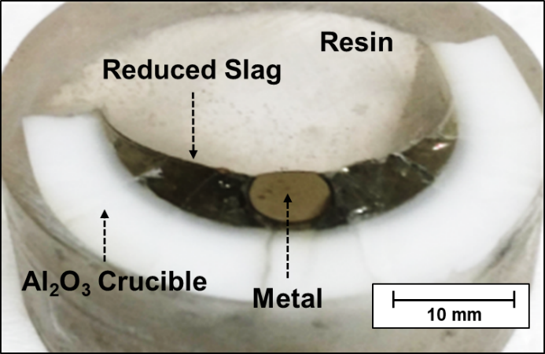
2.2 Result (Phase separation & Composition changes)
Fig. Cross sectioned image after 20 mins reduction
Metal and Slag Separation
Residual graphite on the top of slag
Carbon composition in metal = Saturated
General reduction tendency
Fe P Mn
Al₂O₃ concentration
Dissolution from Al₂O₃ crucible
CaO, SiO₂ and MgO
Fig. Composition changes of Slag B and its reduced
metal (1773 K, Graphite mixing ratio: 200%)
Stable element

Slide 11
2.2 Influence of Slag Basicity (Mass balance of P and Mn)
Decreasing slag basicity
Partition ratio (Slag/Metal) Mn – Increased
P – Decreased
Separation of P and Mn
was achieved by carbon reduction
Fig. The partitions of P and Mn with reduction time under
varying slag basicity

Slide 12
Contents
Separation of P and Mn from Steelmaking Slag by Selective Reduction
1. Introduction
2. Optimum Conditions of Basicity
Influence of Initial Al₂O₃ Content
Conclusion

Slide 13
3.1 Introduction
Considerable dissolution of Al₂O₃ from crucible was observed.
Time (min)
In order to clarify the influence of Al₂O₃ on selective reduction
Different content of Al₂O₃ slag experiment was conducted in detail.

Slide 14
3.2 Reduction behavior of slag with different initial Al₂O₃ contents
Increase in Al₂O₃ content in slag, both the reduction of P and Mn are enhanced simultaneously.
The initial period (0 ~10 min) the reduction behavior of P and Mn were changed by initial Al₂O₃ content.
The late period (10 ~20 min) the reduced mass of Mn were similar.
Reduction behavior of P and Mn
at initial period should be observed.
Slag F and Slag H
were used for observation
Fig. Partitions of P and Mn by different initial
Al₂O₃ content in steelmaking slag

Slide 15
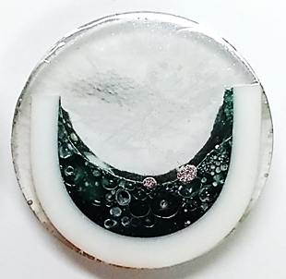
3.3 Melting behavior of slag (Slag F, initial Al₂O₃ = 10%)
10 mm
Reduced Metal
Resin
Reduced Metal
Optical
Slag
Pores
Al₂O₃ Crucible
200µm
Resin
Reduced Metal
Reduced Metal
EPMA
Reduced Metal
Pore
Pore
Slag
Pore
Slag
1 min (Al₂O₃ = 10.6%)
2 min (Al₂O₃ = 12.6%)
3 min (Al₂O₃ = 13.7%)
Slag F (Al₂O₃ = 10%) melted within one minute.
As the reduction time is elongated, reduced metal droplet size increased.
Tiny pores was observed in slag caused by CO gas generation.
Molten state reduction (smelting reduction) was observed at Slag F (Al₂O₃ = 10%)

Slide 16
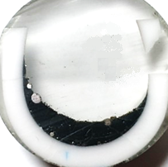
3.3 Melting behavior of slag (Slag H, initial Al₂O₃ = 20%)
Partially melted slag
Partially melted slag
Reduced Metal
Reduced Metal
Optical
Partially melted slag
Slag
Slag
Resin
10 mm
200µm
Reduced Metal
Reduced Metal
Resin
Resin
Resin
Reduced Metal
Slag
EPMA
Slag
Slag
Pore
Reduced Metal
Pore
Slag
Reduced Metal
Resin
Slag
Slag
Slag
1 min (Al₂O₃ = 19.6%)
2 min (Al₂O₃ = 25.0%)
3 min (Al₂O₃ = 24.8%)
4 min (Al₂O₃ = 26.3%)
5 min (Al₂O₃ = 28.1%)
Unlike Slag F (Al₂O₃ = 10%), Slag H (Al₂O₃ = 20%) didn’t melt until 3 min is lasted.
Molten slag was observed after 4 min.
Metal particles were agglomerating and growing in size with reduction time
Reduced metal droplet was observed in entire area of slag
Different melting behavior was observed by different initial Al₂O₃ content of slag.

Slide 17
3.4 Influence of melting behavior on selective reduction
Slag melted
Smelting reduction
Smelting reduction
Solid state reduction
Fig. Composition changes of Slag F and H observed by EPMA & Reduction mechanism
Slag F (Al₂O₃ = 10%) : Slag melted fast, molten slag and graphite is the major reduction reaction
Slag H (Al₂O₃ = 20%) : Slag melted slowly, solid slag and graphite reduction took place for one min
reduction of Mn was enhanced during solid state reduction
Different reduction mechanism leads different reduction behavior of Fe, P and Mn
Since suppressed reduction of Mn is more advantageous for separation of Mn and P,
the formation of molten slag plays an important role in selective reduction process.

Slide 18
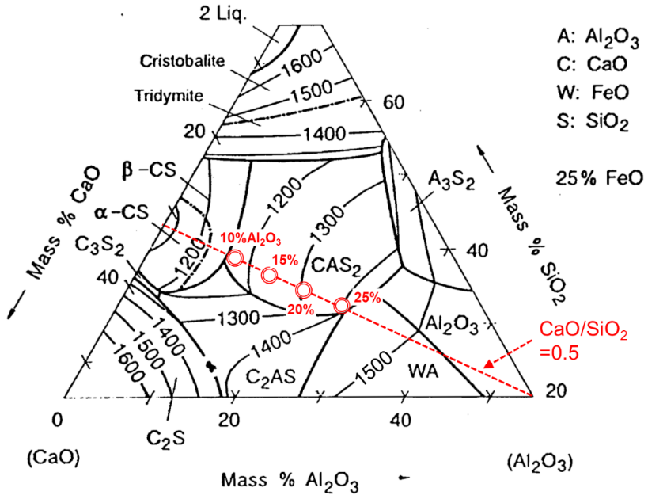
3.5 Discussion (Melting point of slags)
Melting point of slags
As the content of Al₂O₃ increased in slag, the melting point of slag increased
During heating-up step, the reduction of slag began before slag was melted.
Decreasing the content of metallic oxides elevated melting point of slag further.
Formation of molten slag
has been slow down.
(continued solid state reduction)
[1] Verein Deutscher Eisenhüttenleute: Slag atlas 2nd Edition. Verlag Stahleisen GmbH, Düsseldorf, 1995, Germany

Slide 19
3.5 Discussion (Reduction behavior of P and Mn from solid slag)
5[Mn] + P₂O_{5(slag)} = 2[P] + 5MnO_{(slag)}
When aMnO = 0.01 1, at $a_{P_{2}O_{5}}$=10⁻¹³
The reduction of MnO became significant
10% Al₂O₃ content slag
- MnO content is close to liquid state.
25% Al₂O₃ content slag
- MnO content is close to solid state.
Liquid state
If the melting of slag took a time, the reduction of P occurred fast.
After the reduction of P, the reduction of MnO became significant when solid slag remained.
Reduction of P
from Solid state
Solid state
For better selective reduction of P from steelmaking slag, a decreasing in slag melting temperature is important.

Slide 20
Contents
Separation of P and Mn from Steelmaking Slag by Selective Reduction
1. Introduction
2. Optimum Conditions of Basicity
Influence of Initial Al₂O₃ Content
Conclusion

Slide 21
4. Conclusions
Decreasing in slag basicity enhanced reduction of P but, that of Mn was suppressed. When slag basicity is decreased to 0.76, separation of P and Mn was achieved.
Both the reduction of P and Mn are enhanced with increase in Al2O3 content. Melting point of slag was increased by increasing Al2O3 content, and it leads different melting behavior of slag.
When solid state reduction took place for long time, the reduction of Mn enhanced, which deteriorate the selective reduction. Slag with low melting temperature is necessary.

Slide 22
Thank you for kind attention !

